Slide 1
Rotor Hub And Pitch System
Group Members :
Dhruvin Kakdiya
Adharsh Pappinisseri Veedu
Muthu Thirunavukarasu
Syed Mohammed Sikandar
Week number : 04
Date: 21/10/2025
Supervisor: Prof. Peter Quell
Syed Mohammed Sikandar

Slide 2
List of contents
Load Calculations
Torque Calculation
2 D Sketch of Rotor Hub with Pitch Drive
Motor Selection
Syed Mohammed Sikandar

Slide 3
Load calculation
Load | Shakti | Syria
Fx | 1034.29 kN | ≃ 840 kN
Fy | 779.43 kN | ≃ 630 kN
Fxy | 900 kN | ≃ 730 kN
Fz | 800 kN | ≃ 650 kN
Mx | 23056.8 kNm | ≃ 17000 kNm
My | 49553.14 kNm | ≃ 36000 kNm
Mxy | 40000 kNm | ≃ 30000 kNm
Mz | 500 kNm | ≃ 370 kNm
F_{syria} ≃ (160/178)² × F_{shakti}
(Fsyria and Fshakti are the forces for Syria and Shakti, respectively.)
M_{syria} ≃ (160/178)³ × M_{shakti}
(Msyria and Mshakti are the bending moments for Syria and Shakti, respectively.)
Syed Mohammed Sikandar

Slide 4
Torque on Blade side
We have derived the Torque on both Blade side and motor by the guidance of the professor
𝑀𝑧 - Acting wind torque
𝑀_{𝑓𝑟𝑖𝑐} - Friction torque of the pitch bearing
𝐽 - Inertia of blade about the pitch axis
𝜑̈ - Pitch angular acceleration
𝑀=𝑀𝑧+ 𝑀_{𝑓𝑟𝑖𝑐}+ 𝐽. 𝜑
Syed Mohammed Sikandar

Slide 5
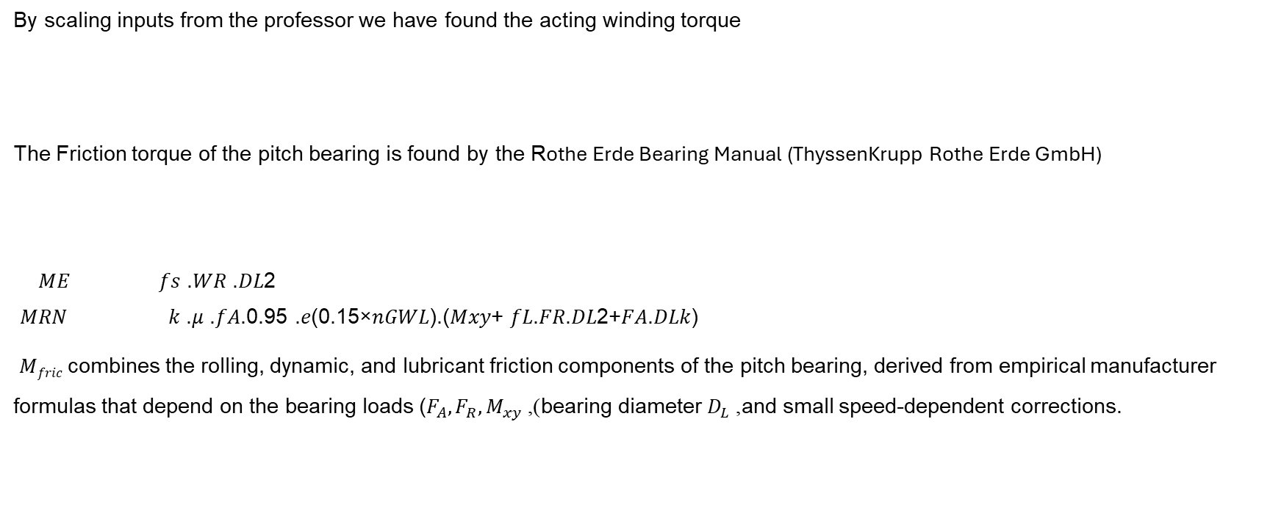
By scaling inputs from the professor we have found the acting winding torque
The Friction torque of the pitch bearing is found by the Rothe Erde Bearing Manual (ThyssenKrupp Rothe Erde GmbH)
𝑀𝐸 𝑓𝑠 .𝑊𝑅 .𝐷𝐿2
𝑀𝑅𝑁 𝑘 .𝜇 .𝑓𝐴.0.95 .𝑒(0.15×𝑛𝐺𝑊𝐿).(𝑀𝑥𝑦+ 𝑓𝐿.𝐹𝑅.𝐷𝐿2+𝐹𝐴.𝐷𝐿𝑘)
​ 𝑀_{𝑓𝑟𝑖𝑐} combines the rolling, dynamic, and lubricant friction components of the pitch bearing, derived from empirical manufacturer formulas that depend on the bearing loads ($F_{A},F_{R},M_{xy}$), bearing diameter $D_{L}$, and small speed-dependent corrections.
𝑀𝑧 = 370 KNm
𝑀_{𝑓𝑟𝑖𝑐} = 𝑀𝐸+𝑀𝑅𝑁
Syed Mohammed Sikandar

Slide 6
𝑓𝑆: Bolt connection factor =1.05
𝑊𝑅: Specific friction force [𝑘𝑁/𝑚] =1.53
𝐷𝐿: Raceway diameter [𝑚]=3.2
𝑘: K-factor =1.17
𝑓𝐴: Adjacent construction factor =1
𝑛𝐺𝑊𝐿: Speed of the large diameter bearing. (𝑛𝑒𝑔𝑙𝑒𝑐𝑡𝑒𝑑)
𝑓𝐿: Raceway factor 𝑓𝐿 = 1.73 (constant)
𝜇: Friction coefficient =0.0015
𝐹𝐴: Axial load [𝑘𝑁]=650
𝐹𝑅: Radial load [𝑘𝑁] =730
Bending moment [𝑘𝑁𝑚] =30000
𝑀𝑓𝑟𝑖𝑐 = 82 KNm
Syed Mohammed Sikandar

Slide 7


Inertia of the Blade (𝐽)
Blade approximated as a ring (mass concentrated at radius)
Estimated radius:
$$r=1.5 \text{m}$$
Estimated blade mass:
$$m_{\text{blade}}=2000 \text{kg}$$
Moment of inertia of the blade:
$J_{\text{blade}}=m_{\text{blade}}⋅r^{2}=2000⋅$(1.5)² = 45,000 Kg/m2
Syed Mohammed Sikandar

Slide 8
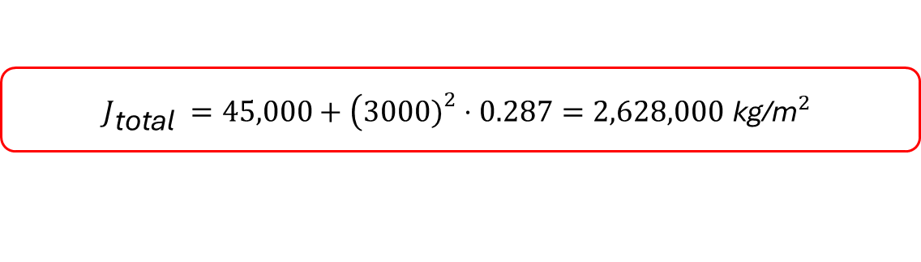
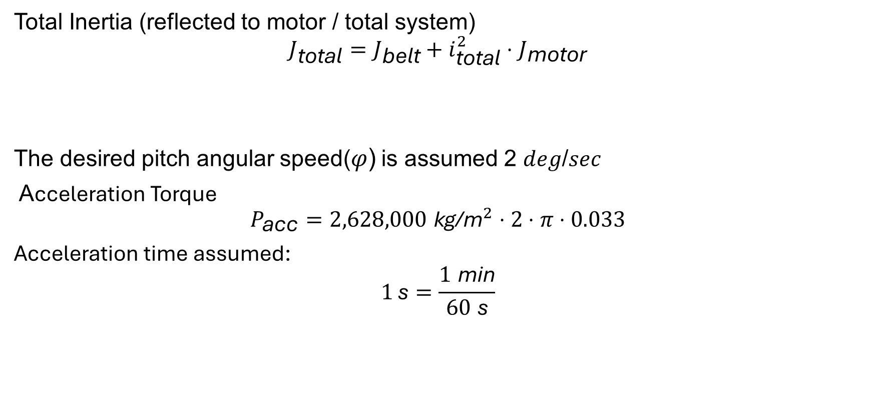
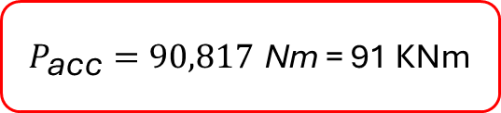
Total Inertia (reflected to motor / total system)
$$J_{\text{total}}=J_{\text{belt}}+i_{\text{total}}^{2}⋅J_{\text{motor}}$$
The desired pitch angular speed(𝜑) is assumed 2 𝑑𝑒𝑔/𝑠𝑒𝑐
Acceleration Torque
$$P_{\text{acc}}=2,628,000 {\text{kg}\text{/}\text{m}}^{2}⋅2⋅π⋅0.033$$
Acceleration time assumed:
$$1 \text{s}=\frac{1 \text{min}}{60 \text{s}}$$
$$J_{\text{total}} =45,000+\left(3000{\left.)\right.}^{2}⋅0.287\right.=2,628,000 {\text{kg}\text{/}\text{m}}^{2}$$
$P_{\text{acc}}=90,817 \text{Nm}$ = 91 KNm
Syed Mohammed Sikandar

Slide 9
Now substituting all these values we get the pitch torque
Provided torque on motor-side:
Bolt Circle diameter of the blade (BCD)
We derived the Gear pitch diameter from Optimus Shakti
𝑀 = 543 KNm
D = 3400 mm
GPD = (3600mm – 3474mm) + 3400 mm = 3526 mm
Syed Mohammed Sikandar

Slide 10
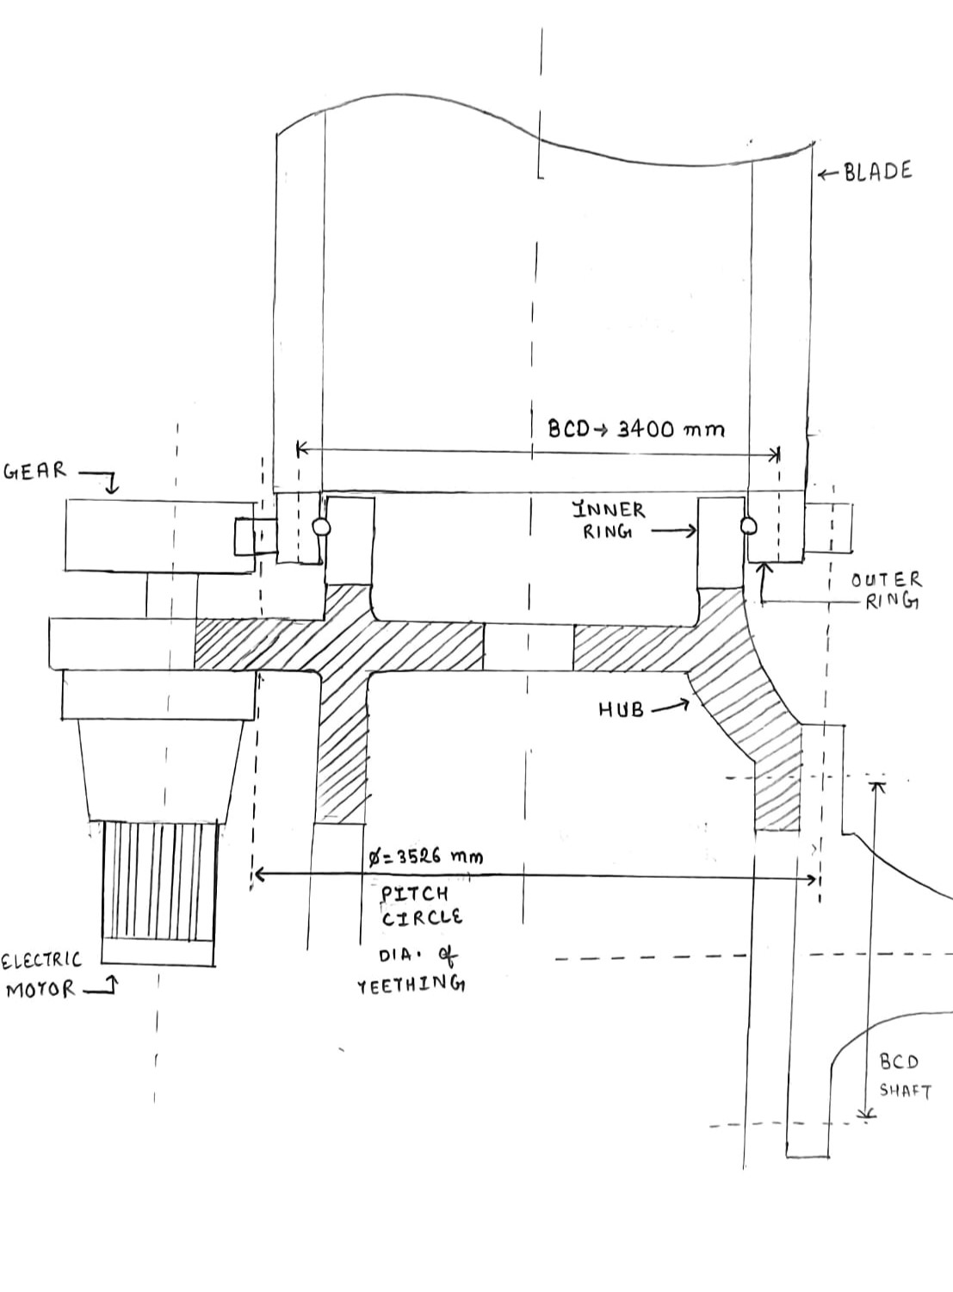
2 D Sketch of Rotor Hub with Pitch Drive
(7)
Syed Mohammed Sikandar

Slide 11
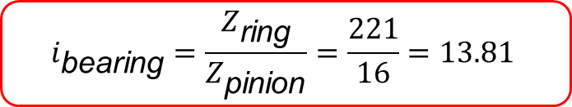
Number of teeth for the ring (𝑍𝑟𝑖𝑛𝑔 )
From dimension relation,
Z=D/m​
Number of teeth for the Pinion (𝑍𝑝𝑖𝑛𝑖𝑜𝑛 )=16
Gear Ratio
𝑍𝑟𝑖𝑛𝑔 =221
$$i_{\text{bearing}}=\frac{Z_{\text{ring}}}{Z_{\text{pinion}}}=\frac{221}{16}=13.81$$
Syed Mohammed Sikandar

Slide 12
Required torque in pinion of gearbox
𝑀_{𝑝𝑖𝑛𝑖𝑜𝑛}= (𝑀 ) / (𝑖_{𝑏𝑒𝑎𝑟𝑖𝑛𝑔} × 𝜂_{𝑟𝑖𝑛𝑔})
= 543 / (13.81×0.96) = 40.95 kNm
Torque on the Motor side
𝑀_{𝑚}=𝑀 /𝑖_{𝑡𝑜𝑡𝑎𝑙} × η_{gear} × η_{pinion}
Here,
𝑀 = 543 KNm
𝑖_{𝑡𝑜𝑡𝑎𝑙} = 𝑖_{gear} · 𝑖_{bearing}
𝑖_{total} = n_{motor} / n_{blade} = (1000 / 2⁰) × (8 / 605) × (360 / 1) = 3000
η_{gear} = 0.93
η_{pinion} = 0.96
𝑀𝑚 = 203 Nm
Syed Mohammed Sikandar

Slide 13
Findings based on Calculations
To drive the pitch system under required load (543 KNm at the blade), the motor must deliver at least 203 Nm at the shaft. So, 203 Nm is the required torque.
However, the initially considered 18.5 kW ABB IE5 synchronous reluctance motor (nominal torque 177 Nm, according to the manufacturer’s technical data) was found to be undersized.
So, we chose the stronger motor with a rated power of 22 kW and a nominal torque of 210 Nm to ensure reliable operation under all expected load conditions.
Syed Mohammed Sikandar

Slide 14
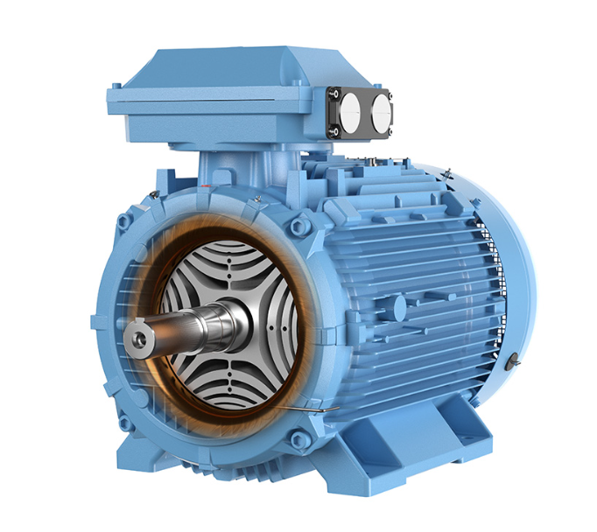
Synchronous AC Reluctance Motor (SynRM)
It is an electric motor where the rotor is designed with magnetic saliency — meaning it has paths of low and high magnetic reluctance.
The motor operates synchronously with the rotating magnetic field of the stator, and torque is produced as the rotor continuously aligns itself to minimize magnetic reluctance
Random Reference image
Syed Mohammed Sikandar

Slide 15
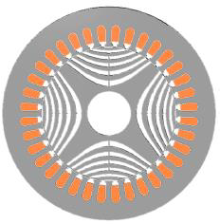
Synchronous Reluctance (SynRM)
Topic | Features
Saliency | Single (Rotor)
Stator | Conventional AC machine
Rotor | Arrangement of internal flux guides
Winding | Polyphase distributed windings
Excitation | Balanced sinusoidal currents
Inductance Waveform | Sinusoidal
Converter | Conventional 3ph Inverter
[1]
Syed Mohammed Sikandar

Slide 16
Advantages of Using SynRM in Wind Pitch Systems
Features | Benefits
High efficiency | Lower energy losses, reduced heat, improved reliability
Magnet-free design | No rare-earth materials, cost-effective, environmentally friendly
High torque at low speeds | Ideal for slow, precise blade angle control
Robustness & reliability | Essential for long-term offshore/onshore wind operation
Simplified maintenance | No brushes or magnets to degrade
Syed Mohammed Sikandar

Slide 17
Motor Specifications
Motor Type | Synchronous AC reluctance (22 kw)
Type designation | M3BL 200MLB 4
Product code | 3GBL202422-●SC
Speed at 100% of nominal power (M) (r/min) | 1000
Motor efficiency with VSD supply* | 95
IE class | IE5
Motor Efficiency | 95%
Maximum Speed | 4500 rpm
Current (A) | 47
Torque | 210 Nm
Rotor inertia (J = 1/4GD2 ) (M) (kgm2 ) | 0.287
Weight, Kg | 304
Temperature rise class (M) | B
[2] ABB IE5 Synchronous reluctance motors
Syed Mohammed Sikandar

Slide 18
Bibliography
https://durham-repository.worktribe.com/output/1382539 [17/10/2025]
https://library.e.abb.com/public/d9f6455b71c7496eb1368e3e5937358d/9AKK107743_IEC%20LV%20Synchronous%20reluctance%20motors_09-2023_lowres.pdf (Page no. 15) [17/10/2025]
https://www.powertransmissionworld.com/high-efficiency-motors-permanent-magnet-synchronous-motors-and-synchronous-reluctance-motors/ [18/10/2025]
https://vbn.aau.dk/ws/files/280749452/Carlos_Imbaquingo___Design_Study_of_a_Permanent_Magnet_Assisted_Synchronous_Reluctance_Generator_for_Wind_Turbines [19/10/2025]
https://www.thyssenkrupp-rotheerde.com/en/products/rothe-erde-slewing-bearings/technical-basics/calculation-of-the-frictional-torque [17/10/25]
Catalog_IE5 SynRM motors [19/10/25]
Handmade 2D Sketch
Syed Mohammed Sikandar

